Slide 1
Business Plan Presentation Guide
FST Concept Car 2013 – Grupo 1

Slide 2
What customer needs
we have to Innovate?
How we intend to fulfill these customers needs?
Why You as An investor should get involved?

Slide 3
Customer:
30-35 Years old
At least 60k€ and above income per year
Automotive enthusiast
Adventurous
Passion for race car
Thrill seeking
Competitive nature
Family of 3-4
At least125k€ household income per year
Close relationship
Adventurous
Passion for race car
Supportive
Competitive nature

Slide 4
What takes a client to buy a race car?
Spend time as a hobby
Engineering interest
Need for Speed
Community
Design and look of the car

Slide 5
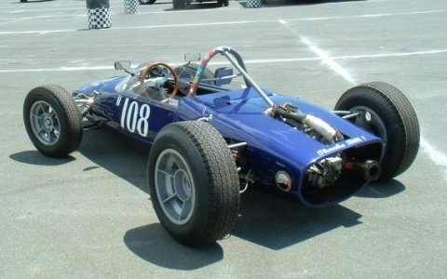
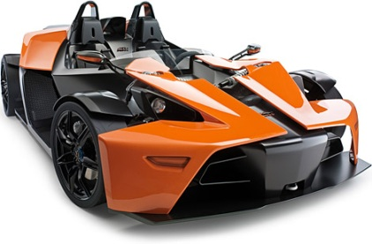
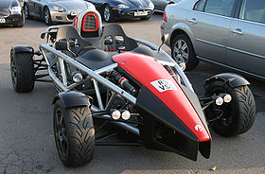
Race car Options in the market
Serious weekend racer
0-100: 3,9 Sec
Lateral G: 1,5
Price: €30000
Fun weekend racer
0-100: 3,9 Sec
Lateral G: 1,2
Price: €89000
Fun weekend racer
0-100: 2,9 Sec
Lateral G: 1,3
Price: €53000

Slide 6
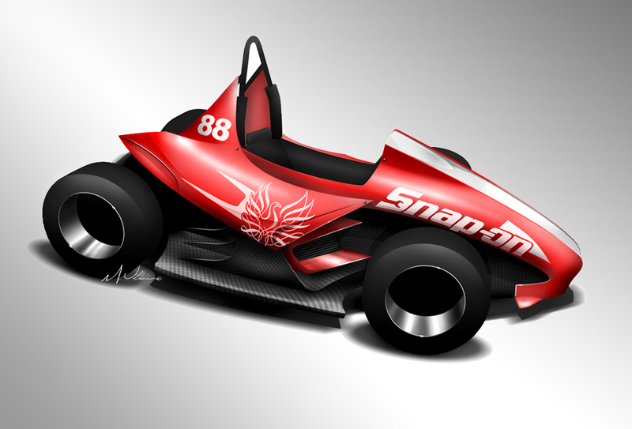
What we offer
Price: € 26000
High performance electrical weekend competition car
Low Cost and affordable
Easy to handle
Green
Adjustability – No need of engineer to set up
Reliability – Safe
Manufacturability – profitable build
Endurance

Slide 7
Upgrades
Anti Roll Bar
Data aquisition
Rims
Power
Custom Seat
Paint job
Aero package
Wheels

Slide 8
Affordable
Cheap production methods – to keep cost down
Optimise parts to be very simple and easy to manufacture and to make it profitable to produce the car
Sustainable
Light weight
Running on electricity
Easy
Easy to drive, do well in corners
Designed suspension and control to set up accordingly to the driver to be fast

Slide 9
Affordable
Secure
Green
Easy
Efficient

Slide 10
Technical Specs and performance
Adjustable in pre defined Steps
Advanced data acquisition
Optical aerodinamical package
Optimum motor performance control
Motor 85kW
Space Frame: Carbon fiber Monocoque
Paddle Shifting:
Weight: 250kg
0-100km/h: 3s
Lateral G: 2G

Slide 11
FEUP Race for Rent
Adjustability
Transporte
Driving instructions
Service on track
Training course

Slide 12
Feup Care & service
Service Agreement
Every 1000 km
Changing components
10000 km Warranty – Fix if breaks
Care Representatives

Slide 13
Feup Virtual Platform
Online applications with access to:
Performance and Setup
Safety and maintenance
Community
Feedback on:
Driving style
Setup
Professional Advice

Slide 14
Data acquisition system
Doing Analisys of setup of car with data fresh from acquisition system online
Measure ecological footprint and reduce fuel economy
Safety-check feature; go through safety check of your car with mobile application

Slide 15
How we intend to fulfill customer needs?
Car equiped with advanced technologie
Quality Services
Reliability through intensive simulation and practice test
Adjustable analysis performance

Slide 16
Target market
Sports Car Club of America - US
60000 Members
7000 aged 40-59
Average Yearly income
4,2% market share within SCCA

Slide 17
Target Market
Russia – Ruassian Amateur Car Clubs
Culture of spending money
Growing interest for motorsport
Host of the first formula 1 competition in 2014

Slide 18
Being present where the customers are
How to reach the initial customers?
Put adds and articles on websites and magazines
SCCA Members presence
48% - speed.com
47% - Grassroots Motorsports
31% - Autoweek
33% - Road and track
Efficient na effective
Marketing

Slide 19
Manufacturing
As a portuguese company we want to implement a flat organisation in which people can interact and comunicate

Slide 20
The way we develop the Feup race car and designed it for efficient manufacturing
Through 3 main features
Knowing our in-house capabilities
Standardization of components
Processes simplification

Slide 21
Effective Production strategy based on analysis
Investment heavy processes
Low-added value parts
Complex sub-assemblies that require complex know-how
Outsourced
Vehicle assembly
Unique components
In-house
To control the final product, regarding safety
and performance

Slide 22
Plant Layout
First start with, bill of material that we use during the prototyping fase.
State some assumptions in order to make it fit to a production complex
Calculate a number of workers and machines for the production workshop
Organize all the preassembly and assembly stages, group them in order to avoid any bottleneck effects in the factory
We are now able to estimate na investment regarding machinery to link na equipment, and finally offer an investment proposal and human resources proposa.

Slide 23
How do We assemble the car?
Only a secure order pulls the assembly of a car.
Starting with a simple chassis, we assemble the car in 5 stages.

Slide 24
How does the Factory works?
Only inputs are on one side and outputs on the other side to avoid any float prossing in the factory, keep some active buffers and keep places for smoothening sake.
Only inputs are on one side and outputs on the other side to avoid any float prossing in the factory, keep some active buffers and keep places for smoothening sake.

Slide 25
How does the Factory works?
The assembly line is supplied with boxes referenced with the same number than the order and the chassis. The idea with these boxes is to supply ready to mount sub assemblies that are prepared in this shop
The Production shop is considered as na internal supplier and its very first job is to turn these orders into a fabrication plan.

Slide 26
Estimation showing a promising financial future
(Financial situation)
Accumulated sold cars year 1-5: 300
Signing FEUP Care&Serviçes: 40%
Factory: €600000
2,1M€
Factory
Salary
R&D Research Development
Marketing

Slide 27
Estimated Sales
Car
Aero Package
FEUP Care&Services
FEUP Virtual

Slide 28
Main risk and preemptive actions possibility
Possibility
Insufficient Funds
- Focus on early cash in
Concept Failure
- Performed market research
FEUP Care&Service
- Cooperation with insurance company and legal advisors
Lack of Performance
- Through testing and quality assurance
Impact

Slide 29
Oportunity
Why should you get involved with in this project?
The oportunity is to invest €2,1M that will cover the start costs
We also need access to:
Sales and distribution Channels
US Network
You will receive:
- 25% Ownership of FEUP RACETEAM Inc.
- We are looking for a Chairman of the board
- 120% Returnal investment in year 5

